Slide 1
Deep Learning in Open Domain Dialogue Generation
Jiwei Li
Computer Science Department
Stanford University
May 10, 2017

Slide 2





Slide 3
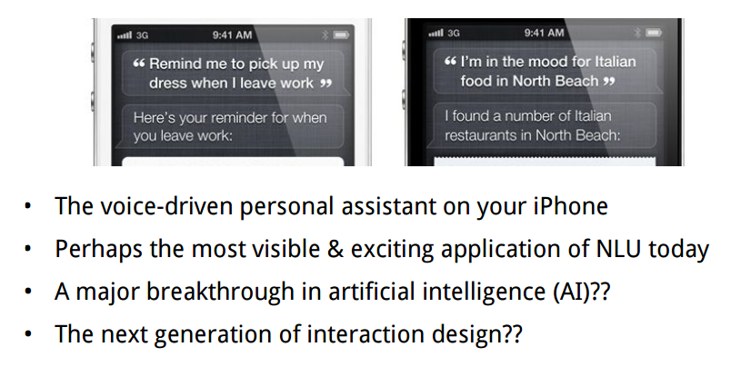
Borrowed From Bill MacCartney’s slides
Notes:
Many people consider siri as a bg breakthrough in AI

Slide 4
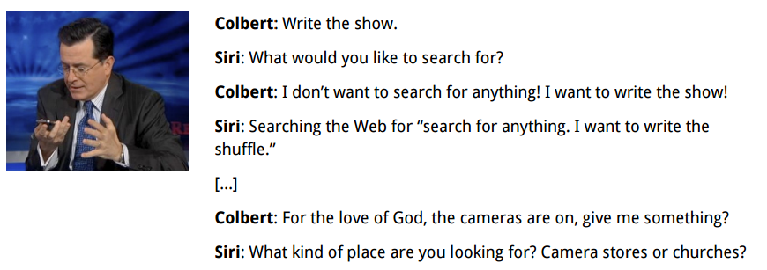
Does Siri really understand language ?
Borrowed From Bill MacCartney’s slides
Notes:
Many of have seen this

Slide 5
Does Siri really understand language ?
Borrowed From Bill MacCartney’s slides
Notes:
Cole-bear

Slide 6
Does Siri really understand language ?
Borrowed From Bill MacCartney’s slides
Notes:
Cole-bear

Slide 7
Does Siri really understand language ?
Borrowed From Bill MacCartney’s slides
Notes:
Many of have seen this

Slide 8
Does Siri really understand language ?
Borrowed From Bill MacCartney’s slides
Notes:
Many of have seen this

Slide 9
Does Siri really understand language ?
Borrowed From Bill MacCartney’s slides
Notes:
Many of have seen this

Slide 10
Does Siri really understand language ?
Borrowed From Bill MacCartney’s slides
Notes:
Many of have seen this

Slide 11
Does Siri really understand language ?
Borrowed From Bill MacCartney’s slides
Notes:
Many of have seen this

Slide 12
Does Siri really understand language ?
Slide Borrowed From Bill MacCartney
Notes:
Many of have seen this

Slide 13
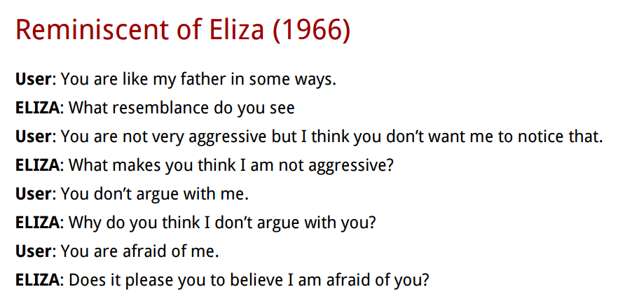
Slide From Bill MacCartney
Notes:
How well a machine can talk with humans has been associted with general sucuessfulness of AI for a long time. The attempt to develop a chatbot dates back to the early days of AI.

Slide 14
How Eliza works
Key word list
….
….
….
….
If a keyword is identified
manipulate the input
Else:
give a generic response, or copy some utterance from dialogue history
Notes:
switching first-person pronouns and second-person pronouns and vice versa

Slide 15
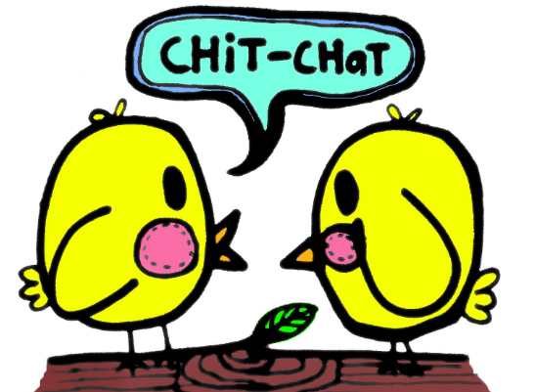
Background
(Ritter et al., 2010, Sordoni, et al., 2015, Vinyals and Le, 2015)
Notes:
They are expensive and hard to be extended to open domain senarios

Slide 16

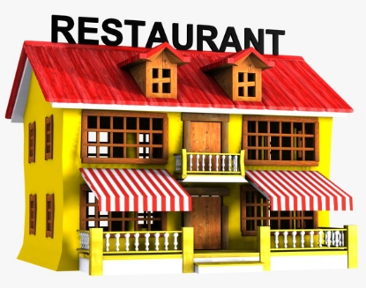
Background
Goal Oriented Tasks
(Ritter et al., 2010, Sordoni, et al., 2015, Vinyals and Le, 2015)
Notes:
They are expensive and hard to be extended to open domain senarios

Slide 17
Why is building a chatbot hard ?
Computers need to understand what you ask.

Slide 18
Why is building a chatbot hard ?
Computers need to understand what you ask.
Computers need to generate coherent, meaningful sequences in response to what you ask,

Slide 19
Why is building a chatbot hard ?
Computers need to understand what you ask.
Computers need to generate coherent, meaningful sequences in response to what you ask, that require domain knowledge, discourse knowledge, world knowledge

Slide 20
Why is building a chatbot hard ?
Computers need to understand what you ask.
Computers need to generate coherent, meaningful sequences in response to what you ask, that require domain knowledge, discourse knowledge, world knowledge
Responses from the same bot need to be consistent.

Slide 21
Why is building a chatbot hard ?
Computers need to understand what you ask.
Computers need to generate coherent, meaningful sequences in response to what you ask, that require domain knowledge, discourse knowledge, world knowledge
Responses from the same bot need to be consistent.
A bot should be interactive.

Slide 22
Background
IR based model
Generation models

Slide 23
IR based model
A big conversation corpus
A: How old are you
B: I am eight
A: What’s your name ?
B: I am john
A: How do you like CS224n?
B: I cannot hate it more.
A: How do you like Jiwei ?
B: He’s such a Jerk !!!!!

Slide 24
IR based model
An new input :
What’s your age ?
A big conversation corpus
A: How old are you
B: I am eight
A: What’s your name ?
B: I am john
A: How do you like CS224n?
B: I cannot hate it more.
A: How do you like Jiwei ?
B: He’s such a Jerk !!!!!

Slide 25
IR based model
An new input :
What’s your age ?
A big conversation corpus
A: How old are you
B: I am eight
A: What’s your name ?
B: I am john
A: How do you like CS224n?
B: I cannot hate it more.
A: How do you like Jiwei ?
B: He’s such a Jerk !!!!!

Slide 26

IR based model
An new input :
What’s your age ?
A big conversation corpus
A: How old are you
B: I am eight
A: What’s your name ?
B: I am john
A: How do you like CS224n?
B: I cannot hate it more.
A: How do you like Jiwei ?
B: He’s such a Jerk !!!!!

Slide 27
IR based model
An new input :
What’s your age ?
A big conversation corpus
A: How old are you
B: I am eight
A: What’s your name ?
B: I am john
A: How do you like CS224n?
B: I cannot hate it more.
A: How do you like Jiwei ?
B: He’s such a Jerk !!!!!
I am eight.

Slide 28
Generation Models

Slide 29
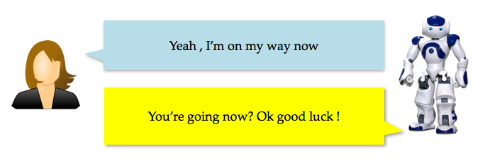
Generation Models
Response Generation as Statistical Machine Translation (Ritter et al., 2010)
Slide borrowed from Michel Galley
Notes:
Predict an output sequence from an input sequence

Slide 30
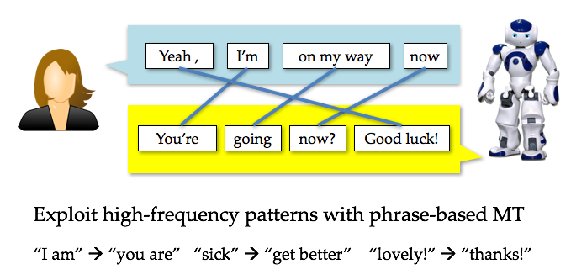
Response Generation as SMT
(Ritter et al., 2010)
Slide borrowed from Michel Galley

Slide 31
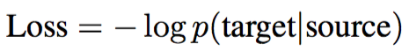
Seq2Seq Models for Response Generation
(Sutskever et al., 2014; Jean et al., 2014; Luong et al., 2015)
Source : Input Messages
Target : Responses
I’m
fine
.
EOS
Encoding
Decoding
how
are
you
?
eos
I’m
fine
.
Notes:
We can adapt this framework to response generation, in which input messages are sources and output responses are mtargets

Slide 32
Seq2Seq Models for Response Generation
how
are
you
?

Slide 33
Seq2Seq Models for Response Generation
Encoding
how
are
you
?

Slide 34
Seq2Seq Models for Response Generation
Encoding
how
are
you
?

Slide 35
Seq2Seq Models for Response Generation
Encoding
how
are
you
?

Slide 36
Seq2Seq Models for Response Generation
Encoding
how
are
you
?

Slide 37
Seq2Seq Models for Response Generation
Encoding
Decoding
how
are
you
?

Slide 38
Seq2Seq Models for Response Generation
I’m
Encoding
Decoding
how
are
you
?
eos

Slide 39
Seq2Seq Models for Response Generation
I’m
fine
Encoding
Decoding
how
are
you
?
eos
I’m

Slide 40
Seq2Seq Models for Response Generation
I’m
fine
.
Encoding
Decoding
how
are
you
?
eos
I’m
fine

Slide 41
Seq2Seq Models for Response Generation
I’m
fine
.
EOS
Encoding
Decoding
how
are
you
?
eos
I’m
fine
.

Slide 42
Sample Results from Google’s paper
Input | Response
what is moral ? | what empowered humanity
what is immoral ? | the fact that you have a child .
what is the purpose of existence ? | to find out what happens when we get to the planet earth .
what do you think about bill gates ? | He’s a good man

Slide 43
Outline
How to deal with generic responses
Consider more context
How to preserve Speaker Consistency
How to foster long-term success
What are the good rewards for dialogue generation
Building interactive bots

Slide 44
Generic Responses

Slide 45
Generic Responses
“I don’t know“ problem (Sordoni et al., 2015; Serban et al.,2015)

Slide 46
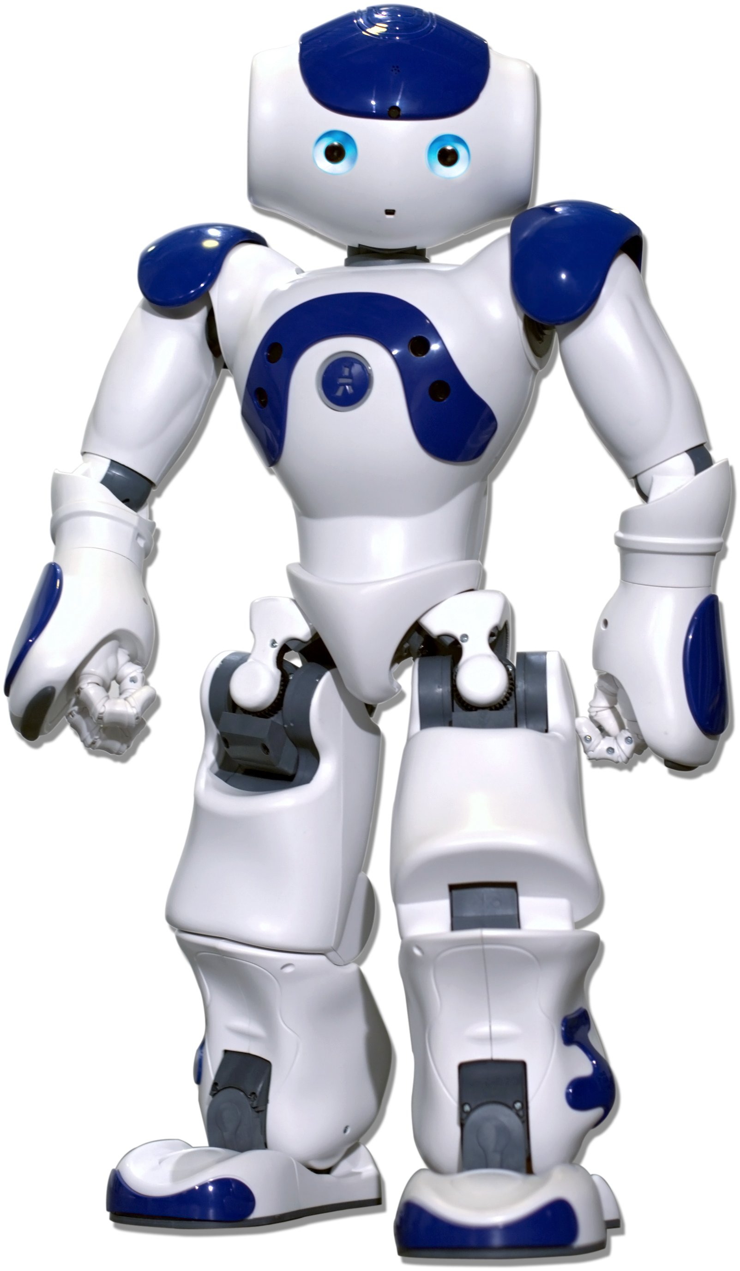

Generic Responses
“I don’t know“ problem (Sordoni et al., 2015; Serban et al.,2015; )
How old are you ?
I don’t know .

Slide 47
Generic Responses
“I don’t know“ problem (Sordoni et al., 2015; Serban et al.,2015; )
How is life ?
I don’t know what you are talking about.
Notes:
30% percent. This behavior is ascribed

Slide 48
How to deal with Generic Responses
“I don’t know“ problem (Sordoni et al., 2015; Serban et al.,2015; )
Do you love me ?
I don’t know what you are talking about.
30% percent of all generated responses
Notes:
30% percent. This behavior is ascribed

Slide 49
How to deal with Generic Responses
Def ChatBot(string):
if string[len(string)-1] == “?”:
return “I don’t know”
else:
return “I don’t know what you are talking about”
Notes:
It is not unreasoble to generate . Developing a chatbot is not just about generating reasonable response

Slide 50
How to deal with Generic Responses
Def ChatBot(string):
if string[len(string)-1] == “?”:
return “I don’t know”
else:
return “I don’t know what you are talking about”
What Eliza is doing !!
Notes:
It is not unreasoble to generate . Developing a chatbot is not just about generating reasonable response

Slide 51
How to deal with Generic Responses
Solution #1: Adding Rules

Slide 52
How to deal with Generic Responses
Solution #1: Adding Rules
I don’t know .
I don’t know ..
I don’t know …
...
I don’t know !
I don’t know ! !
I don’t know ! ! !
Notes:
Regular expression matching

Slide 53
How to deal with Generic Responses
Solution #1: Adding Rules
I don’t have the foggiest idea what you are talking about .
I have no idea .
I don’t know .
I don’t know ..
I don’t know …
...
I don’t know !
I don’t know ! !
I don’t know ! ! !
I don’t have a clue.
I don’t have the lightest idea what you are talking about .
I haven’t the faintest idea
How should I know ?
Notes:
Unfortunately, deep learning model manage to cluster all phrases that are semantically related to I don’t know.
Most comprehensive “I don’t know” list I have ever seen …

Slide 54
How to deal with Generic Responses
Solution #1: Adding Rules
I don’t have the foggiest idea what you are talking about .
I have no idea .
I don’t know .
I don’t know ..
I don’t know …
...
I don’t know !
I don’t know ! !
I don’t know ! ! !
I don’t have a clue.
I don’t have the lightest idea what you are talking about .
I haven’t the faintest idea
How should I know ?
Rules don’t work !!
Notes:
Unfortunately, deep learning model manage to cluster all phrases that are semantically related to I don’t know.
Most comprehensive “I don’t know” list I have ever seen …

Slide 55
Mutual Information for Response Generation.

Slide 56
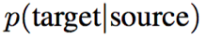
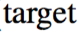
Mutual Information for Response Generation.

Slide 57
Mutual Information for Response Generation.
“I don’t know”
Whatever one asks

Slide 58

Mutual Information for Response Generation.
What one asks
“I don’t know”

Slide 59
Mutual Information for Response Generation.
What one asks
“I don’t know”
“I don’t know”
What one asks
Notes:
The other way around

Slide 60
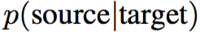
Mutual Information for Response Generation.

Slide 61
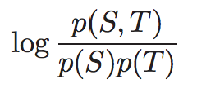
Mutual Information for Response Generation.
Mutual Information

Slide 62
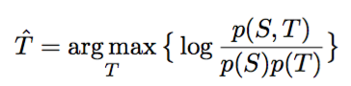
Mutual Information for Response Generation.

Slide 63
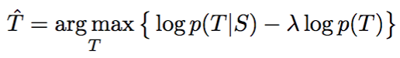
Mutual Information for Response Generation.
Bayesian Rule

Slide 64
Mutual Information for Response Generation.
Bayesian Rule

Slide 65
Mutual Information for Response Generation.
Bayesian Rule

Slide 66
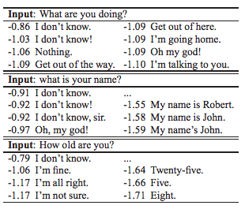
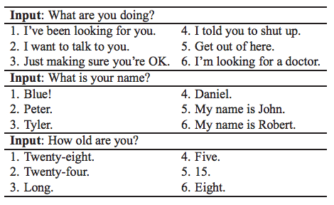
Sampled Results
Standard Seq2Seq p(t|s)
Mutual Information
Notes:
Too small

Slide 67
Outline
How to deal with generic responses
Consider more context
How to preserve Speaker Consistency
How to foster long-term success
What are the good rewards for dialogue generation
Building interactive bots

Slide 68
Multi-context Response Generation
Single Context:
Any particular plan ?
????

Slide 69
Multi-context Response Generation
What’s your plan for the upcoming summer ?
I am going to Hawaii for vocation.
Any particular plan ?
????

Slide 70
Multi-context Response Generation
What’s your plan for the upcoming summer ?
I am going to Hawaii for vocation.
Any particular plan ?
????

Slide 71
Multi-context Response Generation
What’s your plan for the upcoming summer ?
Notations
I am going to Hawaii for vocation.
…
Any particular plan ?
…
????
Response r

Slide 72
Multi-context Response Generation
What’s your plan for the upcoming summer ?
Notations
I am going to Hawaii for vocation.
…
Any particular plan ?
Message: m
????
Response r

Slide 73
Multi-context Response Generation
What’s your plan for the upcoming summer ?
Context c1
Notations
I am going to Hawaii for vocation.
Context c2
…
Any particular plan ?
…
Message: m
????
Response r

Slide 74
Multi-context Response Generation
What’s your plan for the upcoming summer ?
I am going to Hawaii for vocation.
...
Any particular plan ?

Slide 75
Multi-context Response Generation
What’s your plan for the upcoming summer ?
LSTM
h1
I am going to Hawaii for vocation.
h2
...
...
hK
Any particular plan ?
Hm

Slide 76
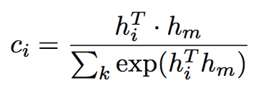
Multi-context Response Generation
What’s your plan for the upcoming summer ?
LSTM
I am going to Hawaii for vocation.
...
...
Any particular plan ?
H

Slide 77
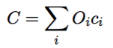
Multi-context Response Generation
What’s your plan for the upcoming summer ?
LSTM
I am going to Hawaii for vocation.
Weighted Sum
...
...

Slide 78
Multi-context Response Generation
What’s your plan for the upcoming summer ?
LSTM
I am going to Hawaii for vocation.
Weighted Sum
...
...
Memory Network (Weston et al., 2014)

Slide 79
Multi-context Response Generation
Encoding
m
Decoding
where
do
you
live
EOS
C

Slide 80
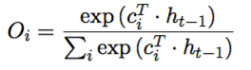
Multi-context Response Generation
Encoding
m
Decoding
where
do
you
live
EOS
C
Attention Models (Bahdanau et al., 2014; Luong et al., 2015)

Slide 81
Multi-context Response Generation
in
Encoding
m
Decoding
where
do
you
live
EOS
C

Slide 82
Multi-context Response Generation
in
uk
Encoding
m
Decoding
where
do
you
live
EOS
C
in
C

Slide 83
Multi-context Response Generation
in
uk
.
Encoding
m
Decoding
where
do
you
live
EOS
C
in
C
uk
C

Slide 84
Multi-context Response Generation
in
uk
.
EOS
Encoding
m
Decoding
where
do
you
live
EOS
C
in
C
uk
C
.
C

Slide 85
Outline
How to deal with generic responses
Consider more context
How to preserve Speaker Consistency
How to foster long-term success
What are the good rewards for dialogue generation
Building interactive bots

Slide 86
Speaker Consistency

Slide 87
Speaker Consistency
How old are you ?
I’m 8 .

Slide 88
Speaker Consistency
How old are you ?
I’m 8 .
What’s your age?
18

Slide 89
Speaker Consistency
Where do you live now?
I live in Los Angeles.

Slide 90
Speaker Consistency
Where do you live now?
I live in Los Angeles.
In which city do you live now?
I live in Paris.

Slide 91
Speaker Consistency
Where do you live now?
I live in Los Angeles.
In which city do you live now?
I live in Paris.
In which country do you live now?
England, you?

Slide 92
Speaker Consistency
How old are you ?
I’m 8.

Slide 93
Speaker Consistency
How old are you ?
I’m 8.
How many kids do you have ?
4, you ?

Slide 94
Speaker Consistency
When were you born ?
In 1942.

Slide 95
Speaker Consistency
When were you born ?
In 1942.
When was your mother born ?
In 1966.
Notes:
You need a knowledgebase to tell you ..

Slide 96
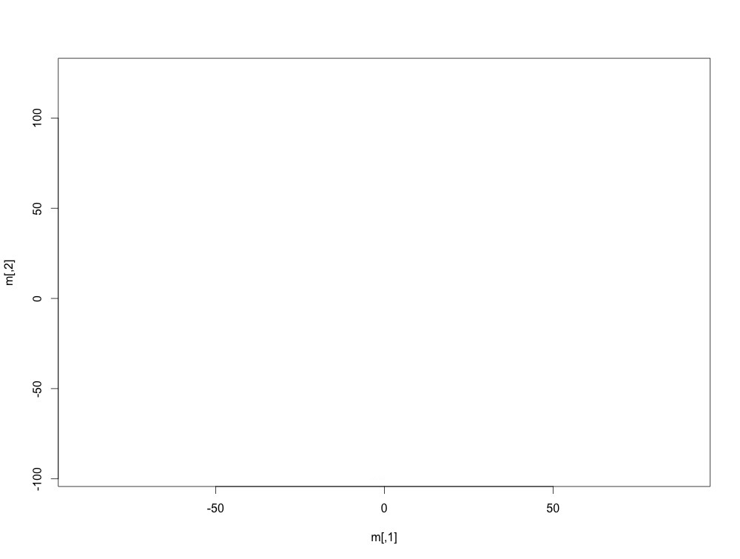


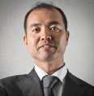

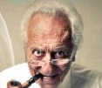
How to represent users
Bob
Persona embeddings (70k)

Slide 97
How to represent users
uk
london
great
sydney
good
Bob
Word embeddings (50k)
monday
live
okay
Persona embeddings (70k)
tuesday
stay

Slide 98
Persona seq2seq model
Encoding
Decoding
where
do
you
live
EOS

Slide 99
Persona seq2seq model
Encoding
Decoding
where
do
you
live
EOS
Bob
Bob
Persona embeddings (70k)

Slide 100
Persona seq2seq model
in
Encoding
Decoding
where
do
you
live
EOS
Bob
Bob
Persona embeddings (70k)

Slide 101
Persona seq2seq model
in
uk
Encoding
Decoding
where
do
you
live
EOS
Bob
in
Bob
Bob
Persona embeddings (70k)

Slide 102
Persona seq2seq model
in
uk
.
Encoding
Decoding
where
do
you
live
EOS
Bob
in
Bob
uk
Bob
Bob
Persona embeddings (70k)

Slide 103
Persona seq2seq model
in
uk
.
EOS
Encoding
Decoding
where
do
you
live
EOS
Bob
in
Bob
uk
Bob
.
Bob
uk
london
Bob
great
sydney
good
Word embeddings (50k)
Persona embeddings (70k)
monday
live
okay
tuesday
stay
Notes:
If you ask one user 100 questions, the 100 responses you will generate are not independent because the same user representation will be incoproaated

Slide 104
Interaction Seq2Seq model
Encoding
where
do
you
live
Notes:
speaker-addressee interaction patterns within the conversation.
Add speaker, addresse

Slide 105
Interaction Seq2Seq model
Encoding
where
do
you
live
tanh(W* )

Slide 106
Interaction Seq2Seq model
in
Encoding
Decoding
where
do
you
live
EOS
tanh(W* )

Slide 107
Interaction Seq2Seq model
in
uk
Encoding
Decoding
where
do
you
live
EOS
in
tanh(W* )

Slide 108
Interaction Seq2Seq model
in
uk
.
Encoding
Decoding
where
do
you
live
EOS
in
uk

Slide 109
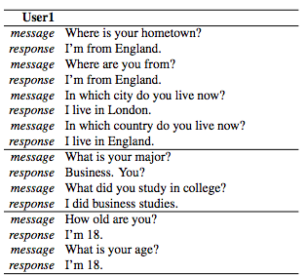
Results (No cherry-picking)

Slide 110
Results (No cherry-picking)

Slide 111
Results (No cherry-picking)

Slide 112
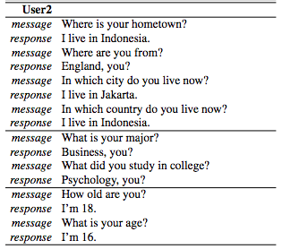
Results (No cherry-picking)

Slide 113
Issues
How do we handle long-term dialogue success?

Slide 114
Outline
How to deal with generic responses
Consider more context
How to preserve Speaker Consistency
How to foster long-term success
What are the good rewards for dialogue generation
Building interactive bots

Slide 115
Issues
How do we handle long-term dialogue success?
Problem 1: Dull and generic responses.

Slide 116
Issues
Problem 1: Dull and generic responses.
“I don’t know“ problem (Sordoni et al., 2015; Serban et al.,2015; )
Do you love me ?
I don’t know what you are talking about.

Slide 117
Issues
How do we handle long-term dialogue success?
Problem 1: Dull and generic responses.
Problem 2: Repetitive responses.

Slide 118
Problem 2: Repetitive responses.
Shut up !

Slide 119
Problem 2: Repetitive responses.
Shut up !
No, you shut up !

Slide 120
Problem 2: Repetitive responses.
Shut up !
No, you shut up !
No, you shut up !

Slide 121
Problem 2: Repetitive responses.
Shut up !
No, you shut up !
No, you shut up !
No, you shut up !

Slide 122
Problem 2: Repetitive responses.
Shut up !
No, you shut up !
No, you shut up !
No, you shut up !
No, you shut up !
……

Slide 123
Problem 2: Repetitive responses.
See you later !
See you later !
See you later !
See you later !
See you later !
……

Slide 124
Issues
How do we handle long-term dialogue success?
Problem 1: Dull and generic responses.
Problem 2: Repetitive responses.
Problem 3: Short-sighted conversation decisions.

Slide 125
Problem 3: Short-sighted conversation decisions.
How old are you ?

Slide 126
Problem 3: Short-sighted conversation decisions.
How old are you ?
i 'm 16 .

Slide 127
Problem 3: Short-sighted conversation decisions.
How old are you ?
i 'm 16 .
16 ?

Slide 128
Problem 3: Short-sighted conversation decisions.
How old are you ?
i 'm 16 .
16 ?
i don 't know what you 're talking about

Slide 129
Problem 3: Short-sighted conversation decisions.
How old are you ?
i 'm 16 .
16 ?
i don 't know what you 're talking about

Slide 130
Problem 3: Short-sighted conversation decisions.
How old are you ?
i 'm 16 .
16 ?
i don 't know what you 're talking about
you don 't know what you 're saying

Slide 131
Problem 3: Short-sighted conversation decisions.
How old are you ?
i 'm 16 .
16 ?
i don 't know what you 're talking about
you don 't know what you 're saying
i don 't know what you 're talking about

Slide 132
Problem 3: Short-sighted conversation decisions.
How old are you ?
i 'm 16 .
16 ?
i don 't know what you 're talking about
you don 't know what you 're saying
i don 't know what you 're talking about
you don 't know what you 're saying

Slide 133
Problem 3: Short-sighted conversation decisions.
Bad Action
How old are you ?
i 'm 16 .
16 ?
i don 't know what you 're talking about
you don 't know what you 're saying
i don 't know what you 're talking about
you don 't know what you 're saying

Slide 134
Problem 3: Short-sighted conversation decisions.
How old are you ?
i 'm 16 .
16 ?
i don 't know what you 're talking about
you don 't know what you 're saying
i don 't know what you 're talking about
you don 't know what you 're saying
Outcome

Slide 135
Can reinforcement learning handle this?
How old are you ?
i 'm 16 .
16 ?
i don 't know what you 're talking about
you don 't know what you 're saying
i don 't know what you 're talking about
you don 't know what you 're saying
Outcome does not emerge until a few turns later

Slide 136
Can reinforcement learning handle this?

Slide 137
Notations for Reinforcement Learning

Slide 138
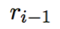
Notations: State
How old are you ?
how
old
are
you
Encoding

Slide 139
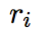
Notations: Action
How old are you ?
i 'm 16 .

Slide 140
Notations: Reward

Slide 141
Notations: Reward
How old are you ?
i 'm 16 .

Slide 142
Notations: Reward
1. Ease of answering

Slide 143
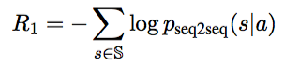
Notations: Reward
1. Ease of answering

Slide 144
Notations: Reward
1. Ease of answering
S: ”I don’t know what you are talking about”
Notes:
We propose to measure the ease of answering a generated turn by using the negative log likelihood of reponding to that utterance with a dull response

Slide 145
Notations: Reward
2. Information Flow

Slide 146
Notations: Reward
2. Information Flow
See you later !
See you later !
See you later !
See you later !

Slide 147
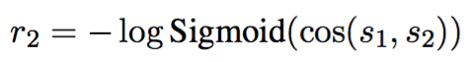
Notations: Reward
2. Information Flow
See you later !
S1
See you later !
S2

Slide 148
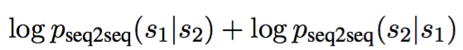
Notations: Reward
3. Meaningfulness
S1
How old are you ?
S2
i 'm 16 .

Slide 149
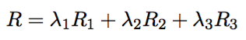
Notations: Reward
Easy to answer R1
Information Flow R2
Meaningfulness R3

Slide 150
Simulation
A message from training set

Slide 151
Simulation
Encode
A message from training set

Slide 152
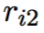
Simulation
Encode
A message from training set
Decode
r1
…

Slide 153
Simulation
Encode
A message from training set
Encode
Decode
r1
…

Slide 154
Simulation
Encode
A message from training set
Encode
Decode
r1
Decode
r2
…

Slide 155
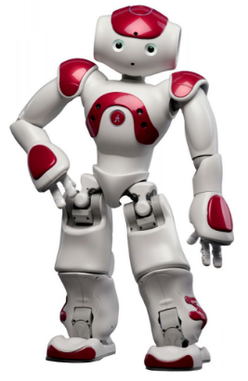
Turn 1
Turn 2
Turn N
…
Input
Message
Encode
Decode
Encode
Decode
Encode
Decode
S1
S2
Sn

Slide 156
Turn 1
Turn 2
Turn N
…
Input
Message
Encode
Decode
Encode
Decode
Encode
Decode
S1
S2
Sn
Compute Accumulated Reward R(S1,S2,…,Sn)

Slide 157
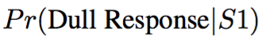
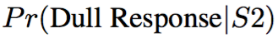
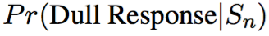
Turn 1
Turn 2
Turn N
…
Input
Message
Encode
Decode
Encode
Decode
Encode
Decode
S1
S2
Sn
Easy to answer

Slide 158
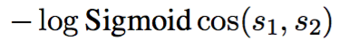
Turn 1
Turn 2
Turn N
…
Input
Message
Encode
Decode
Encode
Decode
Encode
Decode
S1
S2
S3
Easy to answer R1
Information Flow R2

Slide 159
Turn 1
Turn 2
Turn N
…
Input
Message
Encode
Decode
Encode
Decode
Encode
Decode
S1
S2
S3
Easy to answer R1
Information Flow R2
Meaningfulness R3

Slide 160
Turn 1
Turn 2
Turn N
…
Input
Message
Encode
Decode
Encode
Decode
Encode
Decode
S1
S2
S3
Easy to answer R1
Information Flow R2
Meaningfulness R3

Slide 161
Turn 1
Turn 2
Turn N
…
Input
Message
Encode
Decode
Encode
Decode
Encode
Decode
S1
S2
S3
Easy to answer R1
Information Flow R2
Meaningfulness R3

Slide 162
Turn 1
Turn 2
Turn N
…
Input
Message
Encode
Decode
Encode
Decode
Encode
Decode
S1
S2
S3
Easy to answer R1
Information Flow R2
Meaningfulness R3
Compute Accumulated Reward R(S1,S2,…,Sn)

Slide 163
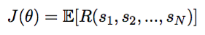
Turn 1
Turn 2
Turn N
…
Input
Message
Encode
Decode
Encode
Decode
Encode
Decode
S1
S2
Sn
REINFORCE Algorithm (William,1992)

Slide 164
Turn 1
Turn 2
Turn N
…
Input
Message
Encode
Decode
Encode
Decode
Encode
Decode
S1
S2
Sn
REINFORCE Algorithm (William,1992)

Slide 165
Turn 1
Turn 2
Turn N
…
Input
Message
Encode
Decode
Encode
Decode
Encode
Decode
S1
S2
Sn
REINFORCE Algorithm (William,1992)

Slide 166
Turn 1
Turn 2
Turn N
…
Input
Message
Encode
Decode
Encode
Decode
Encode
Decode
S1
S2
Sn
REINFORCE Algorithm (William,1992)

Slide 167
Turn 1
Turn 2
Turn N
…
Input
Message
Encode
Decode
Encode
Decode
Encode
Decode
S1
S2
Sn
REINFORCE Algorithm (William,1992)

Slide 168
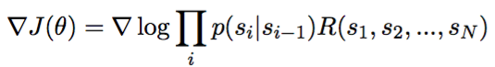
Turn 1
Turn 2
Turn N
…
Input
Message
Encode
Decode
Encode
Decode
Encode
Decode
S1
S2
Sn
REINFORCE Algorithm (William,1992)

Slide 169
Turn 1
Turn 2
Turn N
…
Input
Message
Encode
Decode
Encode
Decode
Encode
Decode
S1
S2
Sn
REINFORCE Algorithm (William,1992)
What we want to learn

Slide 170
Results
Input | Mutual Information | The proposed model
How old are you ? | I’m 16. | I’m 16. why are you asking ?
what is your full name ? | i have no idea | what 's yours ?
I don 't want to go home tonight . | Really ? | Why ?
Do you have any feelings for me ? | I don’t know what you are talking about. | Would I see you if I didn 't ?

Slide 171
Results
Input | Mutual Information | The proposed model
How old are you ? | I’m 16. | I’m 16. why are you asking ?
what is your full name ? | i have no idea | what 's yours ?
I don 't want to go home tonight . | Really ? | Why ?
Do you have any feelings for me ? | I don’t know what you are talking about. | Would I see you if I didn 't ?

Slide 172
Results
Input | Mutual Information | The proposed model
How old are you ? | I’m 16. | I’m 16. why are you asking ?
what is your full name ? | i have no idea | what 's yours ?
I don 't want to go home tonight . | Really ? | Why ?
Do you have any feelings for me ? | I don’t know what you are talking about. | Would I see you if I didn 't ?

Slide 173
Results
Input | Mutual Information | The proposed model
How old are you ? | I’m 16. | I’m 16. why are you asking ?
what is your full name ? | i have no idea | what 's yours ?
I don 't want to go home tonight . | Really ? | Why ?
Do you have any feelings for me ? | I don’t know what you are talking about. | Would I see you if I didn 't ?

Slide 174
Simulation
How old are you ?

Slide 175
Simulation
How old are you ?
i 'm 16, why are you asking ?

Slide 176
Simulation
How old are you ?
i 'm 16, why are you asking ?
I thought you were 12 .

Slide 177
Simulation
How old are you ?
i 'm 16, why are you asking ?
I thought you were 12 .
What made you think so ?

Slide 178
Simulation
How old are you ?
i 'm 16. why are you asking ?
I thought you were 12 .
What made you think so ?
I don’t know what you are talking about .

Slide 179
Simulation
How old are you ?
i 'm 16, why are you asking ?
I thought you were 12 .
What made you think so ?
I don’t know what you are talking about .
You don’t know what you are saying.

Slide 180
Simulation
How old are you ?
i 'm 16, why are you asking ?
I thought you were 12 .
What made you think so ?
I don’t know what you are talking about .
You don’t know what you are saying.
I don’t know what you are talking about .

Slide 181
Simulation
Survive 4 turns !!
How old are you ?
i 'm 16, why are you asking ?
I thought you were 12 .
What made you think so ?
I don’t know what you are talking about .
You don’t know what you are saying.
I don’t know what you are talking about .

Slide 182
Outline

Slide 183
Outline
How to deal with generic responses
Consider more context
How to preserve Speaker Consistency
How to foster long-term success
What are the good rewards for dialogue generation
Building interactive bots

Slide 184
Reward for Good Dialogue

Slide 185
Reward for Good Dialogue
How to evaluate open domain dialogue generation

Slide 186
Reward for Good Dialogue
How to evaluate open domain dialogue generation
Bleu ? Ppl ?

Slide 187
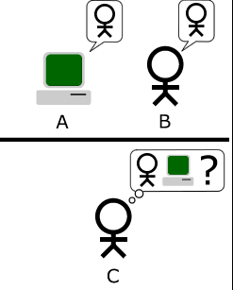
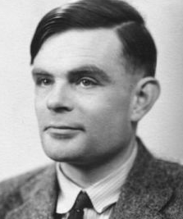
Reward for Good Dialogue
Turing Test
Notes:
Keep an on

Slide 188
Reward for Good Dialogue
Turing Test
I’m 25.
Input
How old are you ?

Slide 189
Reward for Good Dialogue
Turing Test
I’m 25.
Input
How old are you ?
I don’t know what you are talking about

Slide 190
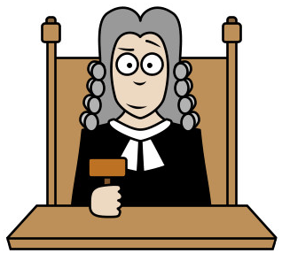
Reward for Good Dialogue
Turing Test
I’m 25.
How old are you ?
I don’t know what you are talking about
A human evaluator/ judge

Slide 191
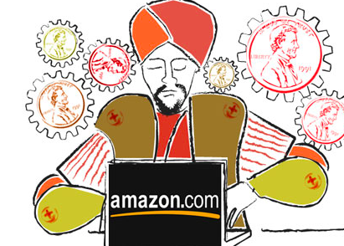
Reward for Good Dialogue
Turing Test
I’m 25.
How old are you ?
I don’t know what you are talking about
A human evaluator/ judge

Slide 192
Reward for Good Dialogue
Turing Test
I’m 25.
How old are you ?
I don’t know what you are talking about
To expensive ?

Slide 193

Reward for Good Dialogue
I’m 25.
How old are you ?
I don’t know what you are talking about

Slide 194


Reward for Good Dialogue
P= 90% human generated
I’m 25.
How old are you ?
I don’t know what you are talking about
P= 10% human generated

Slide 195
Reward for Good Dialogue
P= 90% human generated
I’m 25.
How old are you ?
I don’t know what you are talking about
P= 10% human generated

Slide 196
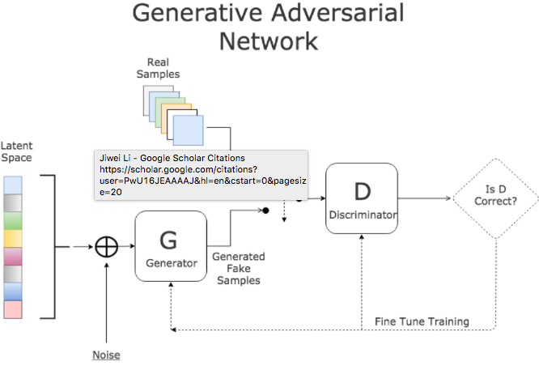
Adversarial Learning in
Image Generation (Goodfellow et al., 2014)
P= 90% human generated
I’m 25.
Discriminator
I don’t know what you are talking about
P= 10% human generated

Slide 197
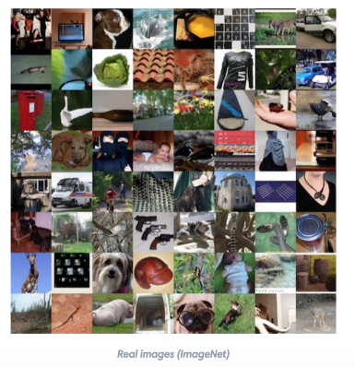
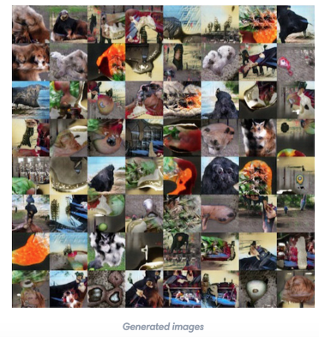
Adversarial Learning in
Image Generation (Goodfellow et al., 2014)
P= 90% human generated
Discriminator
P= 10% human generated

Slide 198
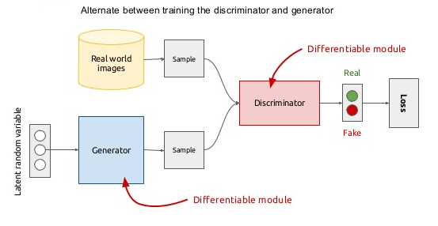
Adversarial Learning in
Image Generation (Goodfellow et al., 2014)

Slide 199
Model Break Down
Generative Model (G)
Discriminative Model (D)

Slide 200
Model Break Down
Generative Model (G)
Discriminative Model (D)

Slide 201
Model Break Down
I’m
fine
.
EOS
Generative Model (G)
Encoding
Decoding
how
are
you
?
eos
I’m
fine
.

Slide 202
Model Break Down
I’m
fine
.
EOS
Generative Model (G)
Encoding
Decoding
how
are
you
?
eos
I’m
fine
.
Discriminative Model (D)
how
are
you
?
eos
I’m
fine
.

Slide 203
Model Break Down
I’m
fine
.
EOS
Generative Model (G)
Encoding
Decoding
how
are
you
?
eos
I’m
fine
.
Discriminative Model (D)
how
are
you
?
eos
I’m
fine
.

Slide 204
Model Break Down
I’m
fine
.
EOS
Generative Model (G)
Encoding
Decoding
how
are
you
?
eos
I’m
fine
.
Discriminative Model (D)
P= 90% human generated
how
are
you
?
eos
I’m
fine
.

Slide 205
Model Break Down
I’m
fine
.
EOS
Generative Model (G)
Encoding
Decoding
how
are
you
?
eos
I’m
fine
.
Discriminative Model (D)
Reward
P= 90% human generated
how
are
you
?
eos
I’m
fine
.

Slide 206
Policy Gradient
Generative Model (G)
I’m
fine
EOS
Encoding
Decoding
how
are
you
?
eos
I’m
fine
.
REINFORCE Algorithm (William,1992)

Slide 207
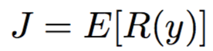
Policy Gradient
Generative Model (G)
I’m
fine
EOS
Encoding
Decoding
how
are
you
?
eos
I’m
fine
.
REINFORCE Algorithm (William,1992)

Slide 208
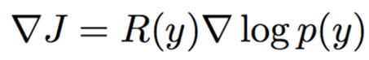
Policy Gradient
Generative Model (G)
I’m
fine
EOS
Encoding
Decoding
how
are
you
?
eos
I’m
fine
.
REINFORCE Algorithm (William,1992)

Slide 209
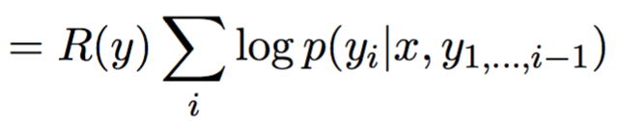
Policy Gradient
Generative Model (G)
I’m
fine
EOS
Encoding
Decoding
how
are
you
?
eos
I’m
fine
.
REINFORCE Algorithm (William,1992)

Slide 210
Policy Gradient
Generative Model (G)
I’m
fine
EOS
Encoding
Decoding
how
are
you
?
eos
I’m
fine
.

Slide 211
Policy Gradient
Generative Model (G)
I’m
fine
EOS
Encoding
Decoding
how
are
you
?
eos
I’m
fine
.
Same reward to all tokens tokens

Slide 212
Policy Gradient
Input : What’s your name
human : I am John
machine : I don’t know

Slide 213
Policy Gradient
Input : What’s your name
human : I am John
machine : I don’t know
REINFORCE assigns the same negative reward to all tokens [I, don’t, know]

Slide 214
Policy Gradient
Input : What’s your name
human : I am John
machine : I don’t know
REINFORCE assigns the same negative reward to all tokens [I, don’t, know]
Negative reward for “ I “

Slide 215
Policy Gradient
Input : What’s your name
human : I am John
machine : I don’t know
REINFORCE assigns the same negative reward to all tokens [I, don’t, know]
Reward for Every Generation Step (REGS)

Slide 216

Policy Gradient
Monte Carlo Search
Figure from Yu et al (2016)

Slide 217

Policy Gradient
Generative Model (G)
I’m
fine
EOS
Encoding
Decoding
how
are
you
?
eos
I’m
fine
.

Slide 218

Policy Gradient
Generative Model (G)
I’m
fine
EOS
Encoding
Decoding
how
are
you
?
eos
I’m
fine
.
Difference

Slide 219

Policy Gradient
Generative Model (G)
I’m
fine
EOS
Encoding
Decoding
how
are
you
?
eos
I’m
fine
.
Actor-critic RL

Slide 220

Adversarial Evaluation: "Adversarial Success"
How often a system can fool a computer into believing that its generated response was from a human
I think "P= 90% human generated"
I don't know
How are you?
The machine evaluator is fooled!!!

Slide 221
Results: Adversarial Learning Improves Response Generation
vs a vanilla generation model
Adversarial Win | Adversarial Lose | Tie
62% | 18% | 20%
Human Evaluator
Adversarial Success
(How often can you fool a machine)
Adversarial Learning | 8.0
Standard Seq2Seq model | 4.9
Machine Evaluator

Slide 222


Adversarial Learning for Neural Dialogue Generation
Update the Discriminator
Update the Generator
The discriminator forces the generator to produce correct responses

Slide 223

Human Evaluation
The previous RL model only perform better on multi-turn conversations

Slide 224
Sample response
Tell me ... how long have you had this falling sickness ?
System | Response
Vanilla-MLE | I’m not a doctor.
Vanilla-Sample | Well everything you did was totally untrue.
REINFORCE | I don’t know how long it’s been.
REGS Monte Carlo (Reward for Every Generation Step) | A few months, I guess.

Slide 225
Outline
How to deal with generic responses
Consider more context
How to preserve Speaker Consistency
How to foster long-term success
What are the good rewards for dialogue generation
Building interactive bots

Slide 226
Introduction
Case 1
How do you like CS224s?

Slide 227

Introduction
Case 1
How do you like CS224s?
What is CS224n?

Slide 228
Introduction
Case 1
How do you like CS224s?
What is CS224n?
Is it a class about speech?

Slide 229
Introduction
Case 1
How do you like CS224s?
What is cs224n?
CS224n is a class about speech and dialogue

Slide 230
Introduction
Case 1
How do you like CS224s?
Who is Hom Tanks?
CS224n is a class about speech and dialogue
Oh. Yeah. I like the class.

Slide 231
Introduction
What will Current Chatbot Systems Do ?
How do you like CS224s?

Slide 232
Introduction
What will Current Chatbot Systems Do ?
How do you like CS224s?
How do you like CS224n?
UNK

Slide 233
Introduction
What will Current Chatbot Systems Do ?
How do you like CS224s?
How do you like UNK ?

Slide 234
Introduction
What will Current Chatbot Systems Do ?
How do you like CS224s?
How do you like UNK ?
Give an output anyway

Slide 235
Introduction
What will Current Chatbot Systems Do ?
How do you like CS224s?
How do you like UNK ?
Forward Backward
softmax

Slide 236
Introduction
What will Current Chatbot Systems Do ?
How do you like CS224s?
How do you like UNK ?
output
I hate it. It‘s really aweful
Forward Backward
softmax

Slide 237
Introduction
What will Current Chatbot Systems Do ?
How do you like CS224s?
Searching the Web for “how do you like CS224n”

Slide 238
We need to the bot to ask questions !!

Slide 239
We Identify three classes of Questions :

Slide 240
three classes of Questions :
Text Clarification - query how to interpret text of dialog partner
Which movie did Tom Hanks star in ?
List, if possible, all movies that Tom Hanks made his appearance in.

Slide 241
three classes of Questions :
Text Clarification - query how to interpret text of dialog partner

Slide 242
Text Clarification

Slide 243
Text Clarification
List, if possible, all movies that Tom Hanks made his appearance in.
What do you mean?

Slide 244
Text Clarification
List, if possible, all movies that Tom Hanks made his appearance in.
AQ
What do you mean?
I mean which film did Tom Hanks appear in.

Slide 245
Text Clarification
List, if possible, all movies that Tom Hanks made his appearance in.
What do you mean?
I mean which film did Tom Hanks appear in.
Forest Gump.

Slide 246
Text Clarification
List, if possible, all movies that Tom Hanks made his appearance in.
What do you mean?
I mean which film did Tom Hanks appear in.
Forest Gump.
That’s correct (+)

Slide 247
Text Clarification
List, if possible, all movies that Tom Hanks made his appearance in.
What do you mean?
Do you mean which movie
Tom Hanks appear in ?
I mean which film did Tom Hanks appear in.
Forest Gump.
That’s correct (+)

Slide 248
Text Clarification
List, if possible, all movies that Tom Hanks made his appearance in.
AQ
QA
What do you mean?
Do you mean which movie
Tom Hanks appear in ?
I mean which film did Tom Hanks appear in.
That’s correct (+)
Forest Gump.
That’s correct (+)

Slide 249
Text Clarification
List, if possible, all movies that Tom Hanks made his appearance in.
AQ
QA
What do you mean?
Do you mean which movie
Did Tom Hanks appear in ?
I mean which film did Tom Hanks appear in.
That’s correct (+)
Forest Gump.
Forest Gump.
That’s correct (+)

Slide 250
Text Clarification
List, if possible, all movies that Tom Hanks made his appearance in.
AQ
QA
What do you mean?
Do you mean which movie
Tom Hanks appear in ?
I mean which film did Tom Hanks appear in.
That’s correct (+)
Forest Gump.
Forest Gump.
That’s correct (+)
That’s correct (+)

Slide 251
three classes of Questions :
Text Clarification - query how to interpret text of dialog partner
Knowledge Operation - query how to perform reasoning steps necessary to answer

Slide 252
Case 2: Knowledge Operation.
Tom Hanks directed Larry Crowne
Tom Hanks starred Forrest Gump
Robert Zemeckis directed Forrest Gump
Knowledge
Base:
which movie Did Tom Hanks appear in ?

Slide 253
Case 2: Knowledge Operation.
Tom Hanks directed Larry Crowne
Tom Hanks starred Forrest Gump
Robert Zemeckis directed Forrest Gump
Knowledge
Base:
which movie Did Tom Hanks appear in ?

Slide 254

Case 2: Knowledge Operation.

Slide 255
Case 2: Knowledge Operation.

Slide 256

Case 2: Knowledge Operation.

Slide 257

Case 2: Knowledge Operation.

Slide 258
Case 2: Knowledge Operation.

Slide 259
Case 2: Knowledge Operation.

Slide 260

In what scenarios does a bot need to ask questions ?
Case 3: Knowledge Acquisition .

Slide 261
three classes of Questions :
Text Clarification - query how to interpret text of dialog partner
Knowledge Operation - query how to perform reasoning steps necessary to answer
Knowledge Acquisition: query to gain missing knowledge necessary to answer
How do you like Hom Tanks?

Slide 262
three classes of Questions :
Text Clarification - query how to interpret text of dialog partner
Knowledge Operation - query how to perform reasoning steps necessary to answer
Knowledge Acquisition: query to gain missing knowledge necessary to answer
Which movie did Tom Hanks star in ?
Not in the KB

Slide 263
Case 3: Knowledge Acquisition .

Slide 264

In what scenarios does a bot need to ask questions ?
Case 3: Knowledge Acquisition .
Not in the KB

Slide 265
In what scenarios does a bot need to ask questions ?
Case 3: Knowledge Acquisition .

Slide 266
In what scenarios does a bot need to ask questions ?
Case 3: Knowledge Acquisition .

Slide 267

In what scenarios does a bot need to ask questions ?
Case 3: Knowledge Acquisition .

Slide 268
In what scenarios does a bot need to ask questions ?
Case 3: Knowledge Acquisition .
… Other questions/ Other answers

Slide 269
In what scenarios does a bot need to ask questions ?
Case 3: Knowledge Acquisition .
… Other questions/ Other answers

Slide 270
In what scenarios does a bot need to ask questions ?
Case 3: Knowledge Acquisition .
… Other questions/ Other answers

Slide 271
three classes of Questions :
Text Clarification - query how to interpret text of dialog partner
Knowledge Operation - query how to perform reasoning steps necessary to answer
Knowledge Acquisition: query to gain missing knowledge necessary to answer

Slide 272

When shall a bot asks a question ?
Shall I ask a question ???

Slide 273
Which movvie did Tom Hanks sttar in?

Slide 274
Which movvie did Tom Hanks sttar in?
AQ
What do you mean?

Slide 275
Which movvie did Tom Hanks sttar in?
AQ
What do you mean?
-CostAQ

Slide 276
Which movvie did Tom Hanks sttar in?
AQ
What do you mean?
-CostAQ
I mean which film did Tom Hanks appear in.

Slide 277
Which movvie did Tom Hanks sttar in?
AQ
What do you mean?
-CostAQ
I mean which film did Tom Hanks appear in.
Forest Gump.

Slide 278
Which movvie did Tom Hanks sttar in?
AQ
What do you mean?
-CostAQ
I mean which film did Tom Hanks appear in.
Forest Gump.
That’s correct (+)
+1

Slide 279
Which movvie did Tom Hanks sttar in?
AQ
What do you mean?
-CostAQ
I mean which film did Tom Hanks appear in.
Forest Gump.
That’s correct (+)
+1
Reward: 1-CostAQ

Slide 280
Which movvie did Tom Hanks sttar in?
AQ
What do you mean?
-CostAQ
I mean which film did Tom Hanks appear in.
Larry Crowne

Slide 281
Which movvie did Tom Hanks sttar in?
AQ
What do you mean?
-CostAQ
I mean which film did Tom Hanks appear in.
Larry Crowne
That’s incorrect (+)
-1

Slide 282
Which movvie did Tom Hanks sttar in?
AQ
What do you mean?
-CostAQ
I mean which film did Tom Hanks appear in.
Larry Crowne
That’s incorrect (+)
-1
Reward: -1-CostAQ

Slide 283
Which movvie did Tom Hanks sttar in?
AQ
QA
What do you mean?
-CostAQ
I mean which film did Tom Hanks appear in.
Forest Gump.
That’s correct (+)
+1
Reward: 1-CostAQ

Slide 284
Which movvie did Tom Hanks sttar in?
AQ
QA
What do you mean?
Larry Crowne
-CostAQ
I mean which film did Tom Hanks appear in.
Forest Gump.
That’s correct (+)
+1
Reward: 1-CostAQ

Slide 285
Which movvie did Tom Hanks sttar in?
AQ
QA
What do you mean?
Larry Crowne
I mean which film did Tom Hanks appear in.
That’s incorrect (--)
Forest Gump.
That’s correct (+)
Reward: 1-CostAQ

Slide 286
Which movvie did Tom Hanks sttar in?
AQ
QA
What do you mean?
Larry Crowne
I mean which film did Tom Hanks appear in.
That’s incorrect (--)
Forest Gump.
Reward: -1
That’s correct (+)
Reward: 1-CostAQ

Slide 287
Which movvie did Tom Hanks sttar in?
AQ
QA
What do you mean?
Forest Gump.
I mean which film did Tom Hanks appear in.
Forest Gump.
That’s correct (+)
Reward: 1-CostAQ

Slide 288
Which movvie did Tom Hanks sttar in?
AQ
QA
What do you mean?
Forest Gump.
I mean which film did Tom Hanks appear in.
That’s correct (+)
Forest Gump.
That’s correct (+)
Reward: 1-CostAQ

Slide 289

Which movvie did Tom Hanks sttar in?
AQ
QA
What do you mean?
Forest Gump.
I mean which film did Tom Hanks appear in.
That’s correct (+)
Forest Gump.
Reward: +1
That’s correct (+)
Reward: 1-CostAQ

Slide 290

Setting2: Reinforcement Learning
Which movvie did Tom Hanks sttar in?
Ask a question or not
Policy Gradient

Slide 291
Setting2: Reinforcement Learning
Memory Network
Ask a question or not …..
Policy Gradient

Slide 292
Setting2: Reinforcement Learning
Memory Network
Ask a question or not …..
Policy Gradient
Baseline

Slide 293
Q&A

